Slide 1
NEURAL NETWORKS

Slide 2
Inspired by biological neural networks
We represent each neuron with a node -> it is basically a directed graph
Each edge has a weight
These neural networks are capable of learning by changing the weights of their connections !!!
Support vector machines and other simpler methods ( linear classifiers ) gradually overtook neural networks in machine learning popularity
With the advent of deep learning neural nets are becoming more and more popular again

Slide 3
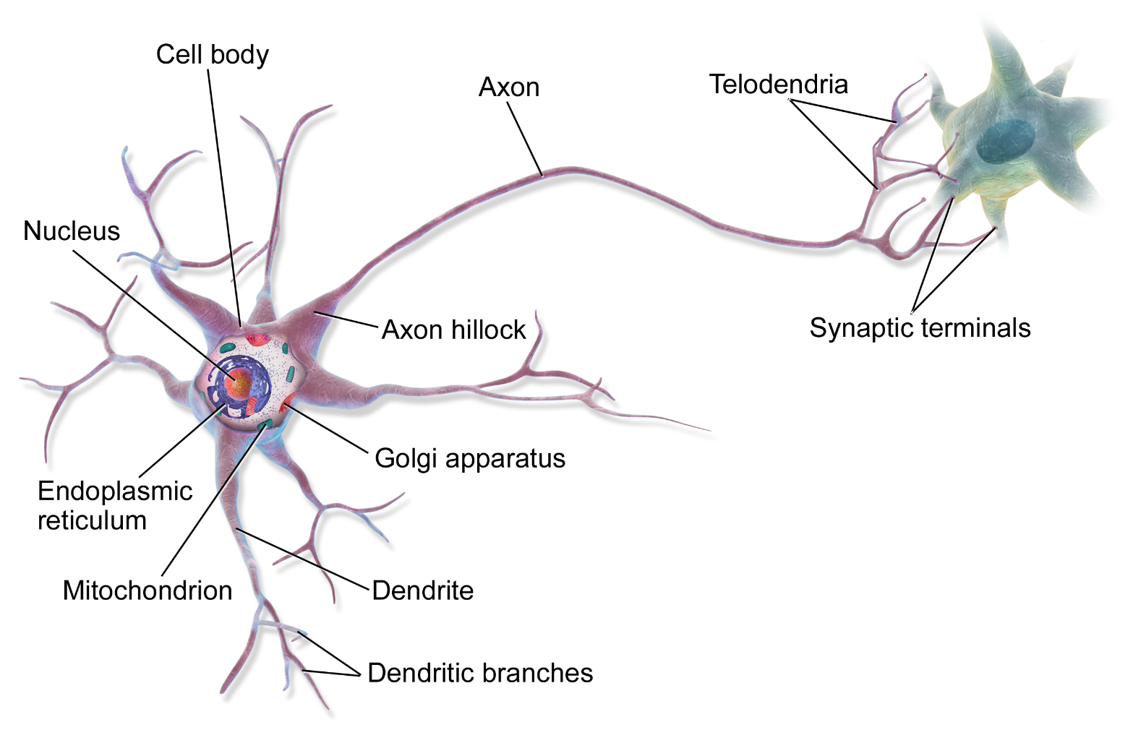

Slide 4
Hopfield neural network: each neuron is connected to every other neuron.
Feedforward neural network: there are directed edges from input layer to hidden layer + from hidden layer to output layer

Slide 5
Hopfield neural network
a
c
b
c

Slide 6
Feedforward neural network
x
O
y
Output layer
Input layer
Hidden layer

Slide 8
AND logical relation
x
y
x AND y
0
0
0
0
1
0
1
0
0
1
1
1

Slide 9
x
y
Input layer
Output layer

Slide 10
x
Every node has a threshold T
If the incoming signal > T -> the neuron
will fire !!!
w1
y
w2
Input layer
Output layer

Slide 11
x
Every node has a threshold T
If the incoming signal > T -> the neuron
will fire !!!
w1
T=2
y
w2
Input layer
Output layer

Slide 12
x
w1 = 1.5
T=2
y
w2 = 1.5
Input layer
Output layer

Slide 13
When x=0 AND y=0 → the result should be 0
x=0
w1 = 1.5
T=2
y=0
w2 = 1.5
Input layer
Output layer

Slide 14
When x=0 AND y=0 → the result should be 0
x=0
w1 = 1.5
T=2
y=0
w2 = 1.5
Input layer
Output layer
Incoming signal to the output node: from x and from y
incomingSignal = xValue * w1 + yValue*w2
if ( incomingSignal > T ) -> neuron will fire / produce a 1 !!!

Slide 15
When x=0 AND y=0 → the result should be 0
x=0
w1 = 1.5
T=2
y=0
w2 = 1.5
Input layer
Output layer
incomingSignal = 0*1.5 + 0*1.5 = 0

Slide 16
When x=0 AND y=0 → the result should be 0
x=0
w1 = 1.5
0
T=2
y=0
w2 = 1.5
Input layer
Output layer
incomingSignal = 0*1.5 + 0*1.5 = 0

Slide 17
When x=1 AND y=0 → the result should be 0
x=1
w1 = 1.5
0
T=2
y=0
w2 = 1.5
Input layer
Output layer
incomingSignal = 1*1.5 + 0*1.5 = 1.5

Slide 18
When x=0 AND y=1 → the result should be 0
x=0
w1 = 1.5
0
T=2
y=1
w2 = 1.5
Input layer
Output layer
incomingSignal = 0*1.5 + 1*1.5 = 1.5

Slide 19
When x=1 AND y=1 → the result should be 1
x=1
w1 = 1.5
1 !!!
T=2
y=1
w2 = 1.5
Input layer
Output layer
incomingSignal = 1*1.5 + 1*1.5 = 3

Slide 21
Training our AND neural network

Slide 22
x
w1
y
w2
Problem: we do not know the correct edge weights in advance
We initialize it with a random number

Slide 23
x
w1= 2
T=2
y
w2 = 3

Slide 24
x
y
x AND y
x
w1= 2
0
0
0
0
1
0
T=2
1
0
0
1
1
1
y
w2 = 3

Slide 25
x
y
x AND y
0
0
0
x
y
x AND y
0
1
1
x
1
0
1
w1= 2
0
0
0
1
1
1
0
1
0
T=2
1
0
0
1
1
1
y
w2 = 3
incomingSignal = sum ( neuronValue * weight )

Slide 26
x
w1= 2
T=2
y
w2 = 3

Slide 27
We construct the training data from out AND logical table. We have 4 (x,y) pairs with
the right answare: we can train out network according to these data
x
w1 = 2
T=2
y
w2 = 3

Slide 28
If (x,y) is (0,0) the correct answer is 0. We test it on our network: there will be probably
an error due to the random weights !!!
X=0
w1 = 2
T=2
y=0
w2 = 3

Slide 29
If (x,y) is (0,0) the correct answer is 0. We test it on our network: there will be probably
an error due to the random weights !!!
X=0
w1 = 2
T=2
y=0
w2 = 3
incomingSignal = 0*2 + 0*3 = 0
Expected according to the logic table: 0
Result: 0
Error: 0

Slide 30
Error calculation
The simplest algorithm: error = rightAnswer – actual
Better approach: ( rightAnswer – actual ) ^ 2
We run our algorithm until theses error terms are very small !!!
We keep updating the edge weights
weight = weight + input * error * learningRate ( < 1 )

Slide 31
If (x,y) is (1,0) the correct answer is 0. We test it on our network: there will be probably
an error due to the random weights !!!
X=1
w1 = 2
T=2
y=0
w2 = 3
incomingSignal = 1*2 + 0*3 = 2
Expected according to the logic table: 0
Result: 1 // because incomingSignal >= T
Error: 0-1 = -1

Slide 32
We have to update the weight !!!
w1 = w1 + 1 * (-1) * 0.1
w2 = w2 + 0 * (-1) * 0.1
X=1
w1 = 2
T=2
y=0
w2 = 3
incomingSignal = 1*2 + 0*3 = 2
Expected according to the logic table: 0
Result: 1 // because incomingSignal >= T
Error: 0-1 = -1

Slide 33
We have to update the weight !!!
w1 = w1 + 1 * (-1) * 0.1
w2 = w2 + 0 * (-1) * 0.1
X=1
w1 = 1.9
T=2
y=0
w2 = 3
incomingSignal = 1*2 + 0*3 = 2
Expected according to the logic table: 0
Result: 1 // because incomingSignal >= T
Error: 0-1 = -1

Slide 35
Output layer
Input layer
Hidden layer

Slide 36
x
y

Slide 37
1
1
x
y
We always need a bias ( with value 1 ): to be able to control the output

Slide 38
1
1
w1
w10
w2
w3
w11
x
w4
w5
w6
w12
w7
y
w8
w9
w13
We always need a bias ( with value 1 ): to be able to control the output

Slide 39
1
1
1
1
1
2
x
2
1.5
1
-2.5
2
0.5
y
2
1
1.5

Slide 40
1
1
1
A
1
1
2
x
2
1.5
1
-2.5
B
2
0.5
y
2
1
C
1.5
How we are able to compute the values for A, B, C? We have to sum up the neuron values
multiply by the edge weights accordingly !!!

Slide 41
1
1
1
A
1
1
2
x
2
1.5
1
-2.5
B
2
0.5
y
2
1
C
1.5

Slide 42
1
1
1
A
1
1
2
x
2
1.5
1
-2.5
B
2
0.5
y
2
1
C
1.5
tempA = biasNode*biasWeight + xValue * xWeightToA + yValue*yWeightToA

Slide 43
1
1
1
A
1
1
2
X=1
2
1.5
1
-2.5
B
2
0.5
Y=0
2
1
C
1.5
tempA = 1*1 + 1*2 + 0*0.5 = 3

Slide 44
We have to use activation functions to calculate the activation
level of the neurons: it yields whether the given neuron will fire or not !!!

Slide 45
y = sign(x)
y
+1
x
-1

Slide 46
1
y =
- x
y
1 + e
x
The sigmoid function. The problem it does not have any negative value

Slide 47
Hyperbolic tangent function
y
x
Sometimes it is better because it
can have negative values as well

Slide 48
1
1
1
A
1
1
2
X=1
2
1.5
1
-2.5
B
2
0.5
Y=0
2
1
C
1.5
tempA = 1*1 + 1*2 + 0*0.5 = 3 → sign(tempA) = +1 !!!

Slide 49
1
1
1
A=1
1
1
2
X=1
2
1.5
1
-2.5
B
2
0.5
Y=0
2
1
C
1.5
tempA = 1*1 + 1*2 + 0*0.5 = 3 → sign(tempA) = +1 !!!

Slide 50
1
1
1
A=1
1
1
2
X=1
2
1.5
1
-2.5
B
2
0.5
Y=0
2
1
C
1.5
tempB = bias * biasWeight + xValue * xWeightToB + yValue * yWeightToB

Slide 51
1
1
1
A=1
1
1
2
X=1
2
1.5
1
-2.5
B
2
0.5
Y=0
2
1
C
1.5
tempB = 1 * 2 + 1 * 1 + 0 * 2 = 3

Slide 52
1
1
1
A=1
1
1
2
X=1
2
1.5
1
-2.5
B=1
2
0.5
Y=0
2
1
C
1.5
tempB = 1 * 2 + 1 * 1 + 0 * 2 = 3 → sign(tempB) = +1

Slide 53
1
1
1
A=1
1
1
2
X=1
2
1.5
1
-2.5
B=1
2
0.5
Y=0
2
1
C
1.5
tempB =bias * biasWeight + xValue * xWeightToC + yValue * yWeightToC

Slide 54
1
1
1
A=1
1
1
2
X=1
2
1.5
1
-2.5
B=1
2
0.5
Y=0
2
1
C
1.5
tempB = 1 * 1,5 + 1 * (-2.5) + 0 * 1 = -1

Slide 55
1
1
1
A=1
1
1
2
X=1
2
1.5
1
-2.5
B=1
2
0.5
Y=0
2
1
C=-1
1.5
tempB = 1 * 1,5 + 1 * (-2.5) + 0 * 1 = -1 → sign(tempC) = -1

Slide 56
1
1
1
A=1
1
1
2
X=1
2
1.5
1
-2.5
B=1
2
0.5
Y=0
2
1
C=-1
1.5

Slide 57
1
1
1
A=1
1
1
2
X=1
2
1.5
1
-2.5
B=1
2
0.5
Y=0
2
1
C=-1
1.5
tempOutput = biasValue * biasWeight + valueA * weightA + ...

Slide 58
1
1
1
A=1
1
1
2
X=1
2
1.5
1
-2.5
B=1
2
0.5
Y=0
2
1
C=-1
1.5
tempOutput = 1 * 1 + 1 * 1 + 1 * 2 + (-1) * 1.5 = 2.5

Slide 59
1
1
1
A=1
1
1
2
X=1
2
1.5
1
-2.5
B=1
2
+1
0.5
Y=0
2
1
C=-1
1.5
tempOutput = 1 * 1 + 1 * 1 + 1 * 2 + (-1) * 1.5 = 2.5 → sign(tempOutput) = +1

Slide 61
y
x

Slide 62
y
x

Slide 63
We have trainig data: (x,y) pairs + whether it is under the line
or not
y
x

Slide 64
y
x

Slide 65
After training our neural network: if we have a (x,y) pair, we can predict
Whether it is under the line or not
y
x

Slide 66
y
x

Slide 67
y
x

Slide 69
Applications of neural networks

Slide 70
Optical character recognition
We have an image and want to find out what character it is
Input layer:
For example we have a 8x8 pixel image ( 64 pixels )
In this situation we have 64 input neuron
Output layer
We have 26 output neurons because in the english alphabet there are 26 characters

Slide 71
Stock market forcast
Stock price
time

Slide 72
Stock market forcast
Stock price
We construct a training data,
3 data point + the next one
We want to make prediction if
we have 3 points -> what will
be the stock price tomorrow?
time

Slide 73
Stock market forcast
Stock price
#1 price
#2 price
#3 price
predict
time

Slide 74
Stock market forcast
Stock price
#1 price
#2 price
#3 price
predict
p11
time

Slide 75
Stock market forcast
Stock price
#1 price
#2 price
#3 price
predict
p11
p12
time

Slide 76
Stock market forcast
Stock price
#1 price
#2 price
#3 price
predict
p11
p12
p13
time

Slide 77
Stock market forcast
Stock price
#1 price
#2 price
#3 price
predict
p11
p12
p13
P1
time

Slide 78
Stock market forcast
Stock price
#1 price
#2 price
#3 price
predict
p11
p12
p13
P1
time

Slide 79
Stock market forcast
Stock price
#1 price
#2 price
#3 price
predict
p11
p12
p13
P1
p21
time

Slide 80
Stock market forcast
Stock price
#1 price
#2 price
#3 price
predict
p11
p12
p13
P1
p21
p22
time

Slide 81
Stock market forcast
Stock price
#1 price
#2 price
#3 price
predict
p11
p12
p13
P1
p21
p22
p23
time

Slide 82
Stock market forcast
Stock price
#1 price
#2 price
#3 price
predict
p11
p12
p13
P1
p21
p22
p23
P2
time

Slide 83
Stock market forcast
Stock price
#1 price
#2 price
#3 price
predict
p11
p12
p13
P1
p21
p22
p23
P2
time

Slide 84
Stock market forcast
Stock price
#1 price
#2 price
#3 price
predict
p11
p12
p13
P1
p21
p22
p23
P2
p31
p32
p33
P3
time

Slide 85
Stock market forcast
Stock price
#1 price
#2 price
#3 price
predict
p11
p12
p13
P1
p21
p22
p23
P2
p31
p32
p33
P3
p41
p42
p43
P4
time

Slide 86
Stock market forcast
Stock price
#1 price
#2 price
#3 price
predict
p11
p12
p13
P1
p21
p22
p23
P2
p31
p32
p33
P3
p41
p42
p43
P4
x
y
z
?
time
We train our neural network on these data: if we provide (x,y,z) three previous
value -> it may predict the stock prie tomorrow !!!

